Slide 1
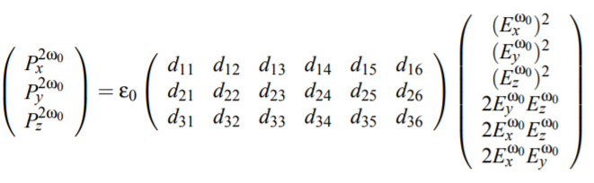
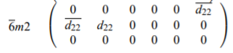
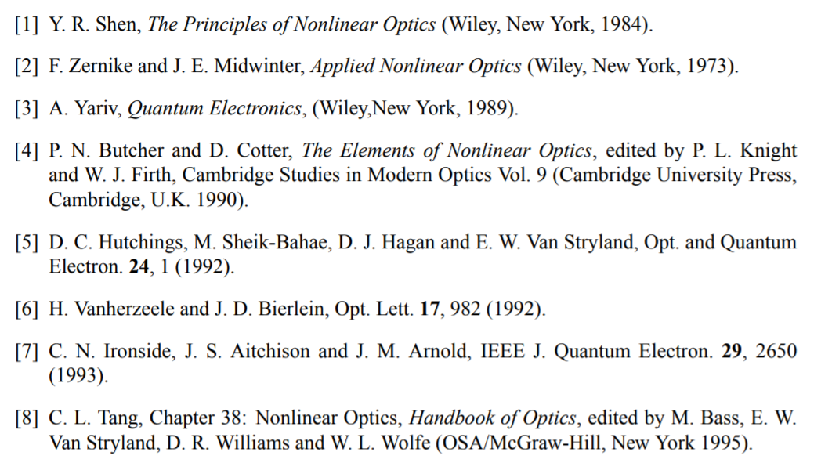
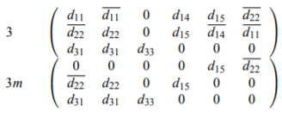
http://www.physics.ucc.ie/fpetersweb/FrankWeb/courses/PY4118/Notes/Symmetry%20of%20Tensor%202.pdf

Slide 2
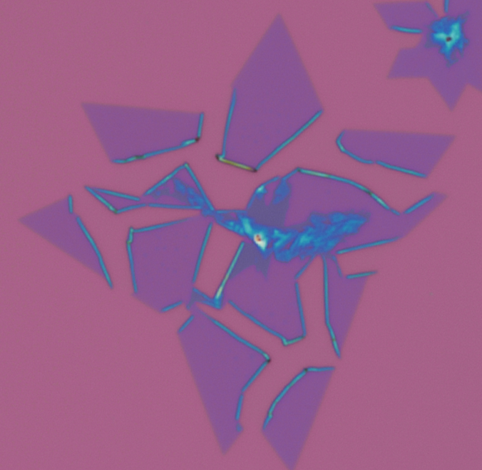
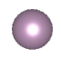
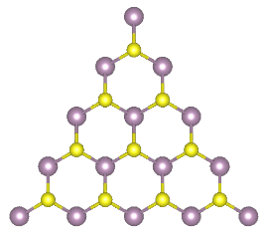

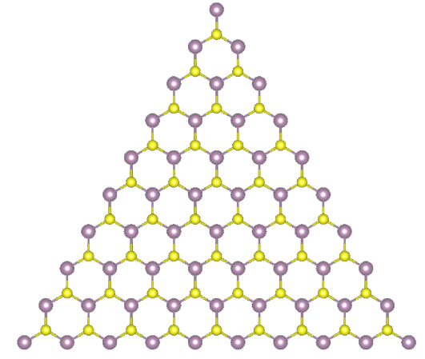
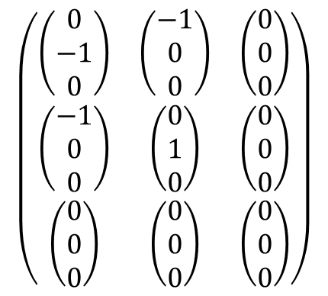
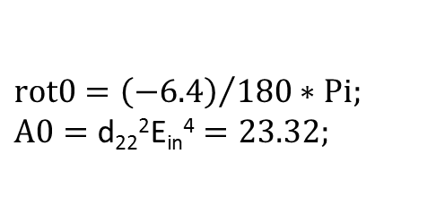
6.4°
y
Mo
x
S
71.2°
42.1°
a
b
c
y
6.4°
Mo
x
For y, peak shifts to 9.6º
S
X detection:
d₂₂²(Sin[2 θ-3 ɸ])²E_{in}⁴
Y detection:
d₂₂²(Cos[2 θ-3 ɸ])²E_{in}⁴
$$\left(\begin{matrix}\left(\begin{matrix}0 \\ −1 \\ 0\end{matrix}\right) & \left(\begin{matrix}−1 \\ 0 \\ 0\end{matrix}\right) & \left(\begin{matrix}0 \\ 0 \\ 0\end{matrix}\right) \\ \left(\begin{matrix}−1 \\ 0 \\ 0\end{matrix}\right) & \left(\begin{matrix}0 \\ 1 \\ 0\end{matrix}\right) & \left(\begin{matrix}0 \\ 0 \\ 0\end{matrix}\right) \\ \left(\begin{matrix}0 \\ 0 \\ 0\end{matrix}\right) & \left(\begin{matrix}0 \\ 0 \\ 0\end{matrix}\right) & \left(\begin{matrix}0 \\ 0 \\ 0\end{matrix}\right)\end{matrix}\right)$$
X detection:
d₂₂²(Sin[3 θ-3 ɸ])²E_{in}⁴
Y detection:
d₂₂²(Cos[3 θ-3 ɸ])²E_{in}⁴
$$rot0={\left(−6.4\right)}/{180}∗Pi;$$
$$A0=\text{d}\text{22}\text{2}\text{E}\text{in}\text{4}=23.32;$$
For y, peak shifts to 6.4º

Slide 3
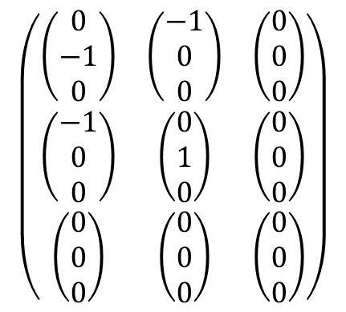
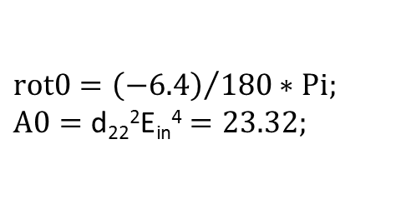
6.4°
y
Mo
x
S
71.2°
42.1°
a
b
y
6.4°
Mo
x
For y, peak shifts to 9.6º
S
X detection:
d₂₂²(Sin[2 θ-3 ɸ])²E_{in}⁴
Y detection:
d₂₂²(Cos[2 θ-3 ɸ])²E_{in}⁴
76.9
44.9
c
d
X detection:
d₂₂²(Sin[3 θ-3 ɸ])²E_{in}⁴
Y detection:
d₂₂²(Cos[3 θ-3 ɸ])²E_{in}⁴
$$\left(\begin{matrix}\left(\begin{matrix}0 \\ −1 \\ 0\end{matrix}\right) & \left(\begin{matrix}−1 \\ 0 \\ 0\end{matrix}\right) & \left(\begin{matrix}0 \\ 0 \\ 0\end{matrix}\right) \\ \left(\begin{matrix}−1 \\ 0 \\ 0\end{matrix}\right) & \left(\begin{matrix}0 \\ 1 \\ 0\end{matrix}\right) & \left(\begin{matrix}0 \\ 0 \\ 0\end{matrix}\right) \\ \left(\begin{matrix}0 \\ 0 \\ 0\end{matrix}\right) & \left(\begin{matrix}0 \\ 0 \\ 0\end{matrix}\right) & \left(\begin{matrix}0 \\ 0 \\ 0\end{matrix}\right)\end{matrix}\right)$$
$$rot0={\left(−6.4\right)}/{180}∗Pi;$$
$$A0=\text{d}\text{22}\text{2}\text{E}\text{in}\text{4}=23.32;$$
For y, peak shifts to 6.4º

Slide 5
a
b

Slide 6
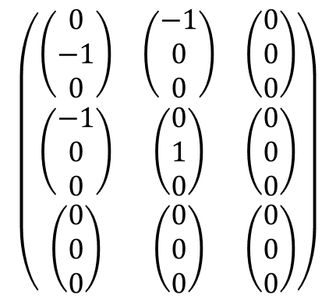
6.4°
y
Mo
x
S
71.2°
42.1°
a
b
y
6.4°
Mo
x
For y, peak shifts to 9.6º
S
X detection:
d₂₂²(Sin[2 θ-3 ɸ])²E_{in}⁴
Y detection:
d₂₂²(Cos[2 θ-3 ɸ])²E_{in}⁴
$$\left(\begin{matrix}\left(\begin{matrix}0 \\ −1 \\ 0\end{matrix}\right) & \left(\begin{matrix}−1 \\ 0 \\ 0\end{matrix}\right) & \left(\begin{matrix}0 \\ 0 \\ 0\end{matrix}\right) \\ \left(\begin{matrix}−1 \\ 0 \\ 0\end{matrix}\right) & \left(\begin{matrix}0 \\ 1 \\ 0\end{matrix}\right) & \left(\begin{matrix}0 \\ 0 \\ 0\end{matrix}\right) \\ \left(\begin{matrix}0 \\ 0 \\ 0\end{matrix}\right) & \left(\begin{matrix}0 \\ 0 \\ 0\end{matrix}\right) & \left(\begin{matrix}0 \\ 0 \\ 0\end{matrix}\right)\end{matrix}\right)$$
c
d
X detection:
d₂₂²(Sin[3 θ-3 ɸ])²E_{in}⁴
Y detection:
d₂₂²(Cos[3 θ-3 ɸ])²E_{in}⁴
$$rot0={\left(−6.4\right)}/{180}∗Pi;$$
$$A0=\text{d}\text{22}\text{2}\text{E}\text{in}\text{4}=23.32;$$
For y, peak shifts to 6.4º

Slide 7
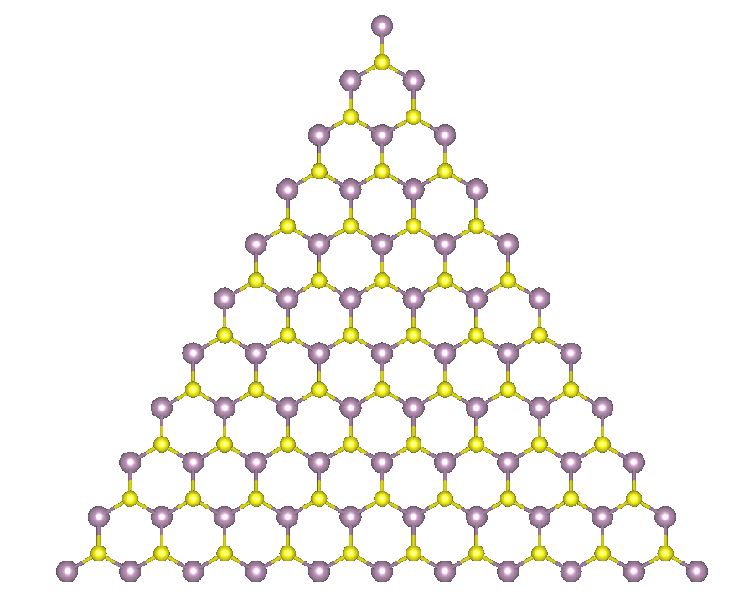
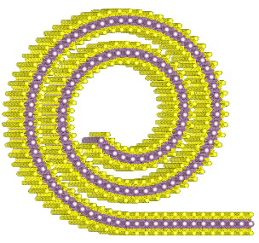
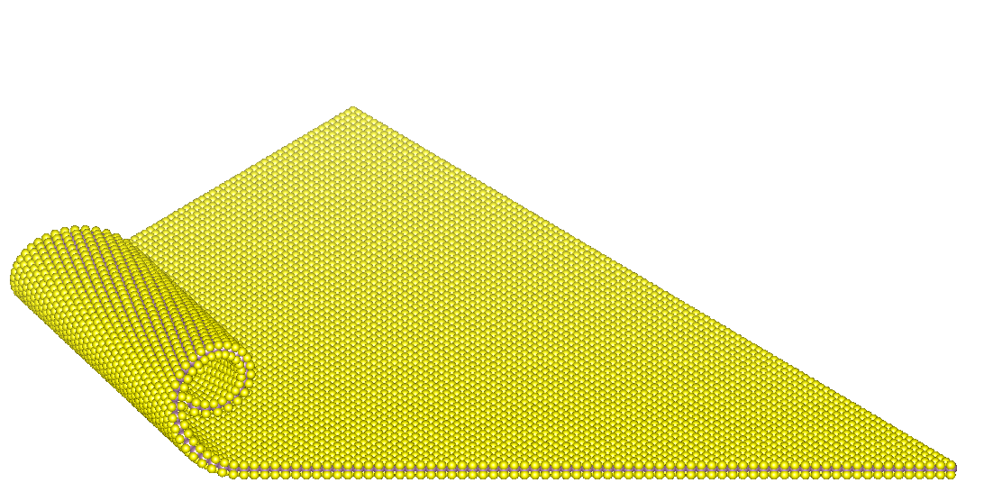
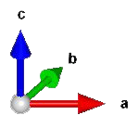
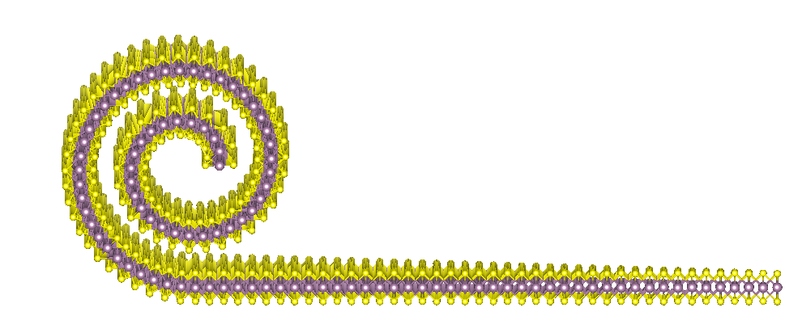
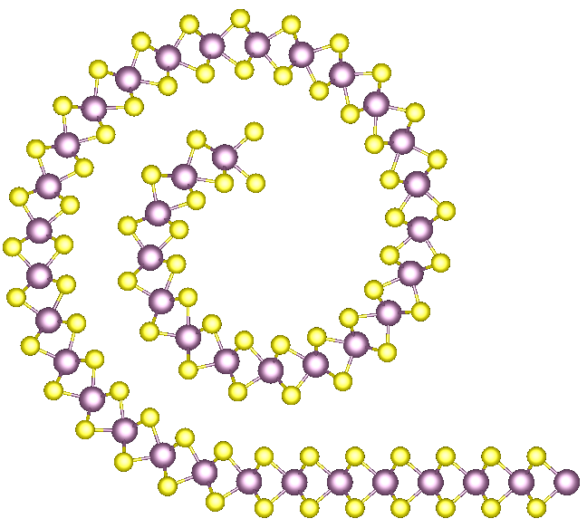
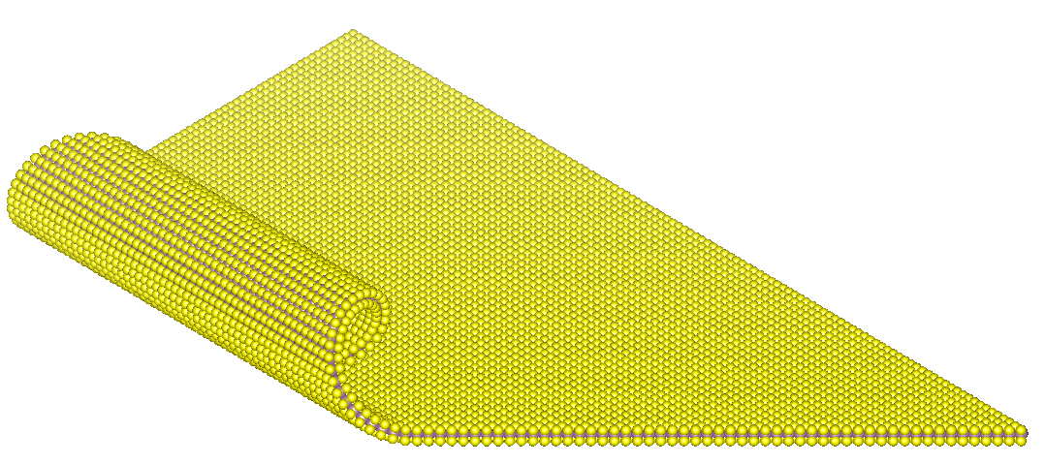
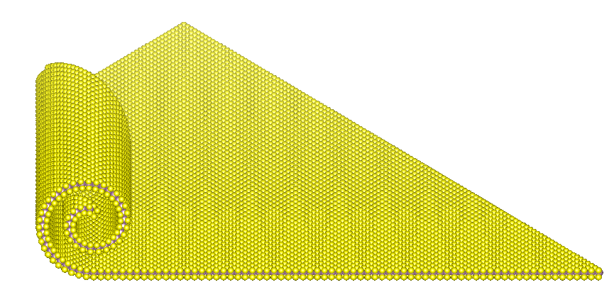
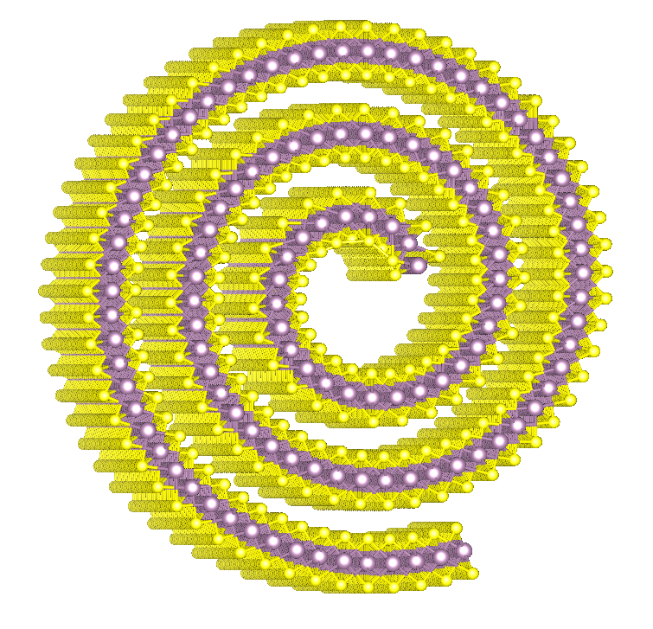
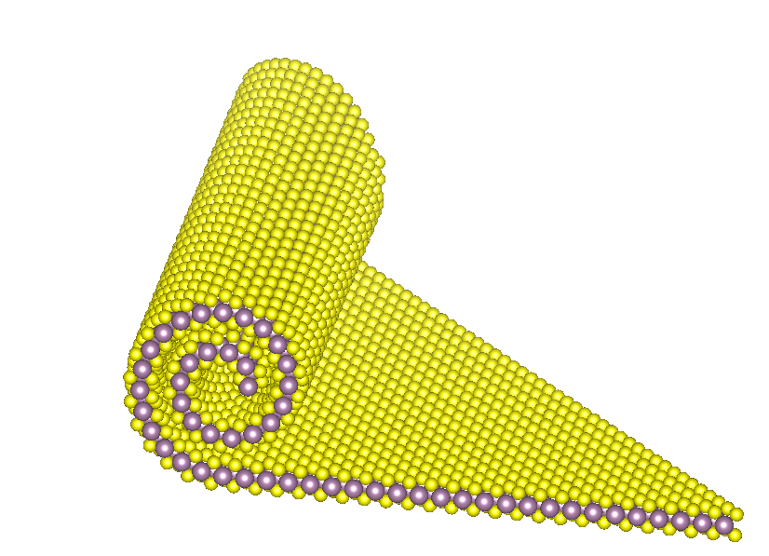
a
b
E_{in}(ω)
E_{in}(ω)
E_{in}(ω)
E_{in}(ω)
E_{out}(2ω)
E_{out}(2ω)
E_{out}(2ω)
E_{out}(2ω)
θ_{roll}
c
d
θ_{roll} = 0°
θ_{roll} = 0°
θ_{roll} = 30°
θ_{roll} = 30°
e

Slide 9
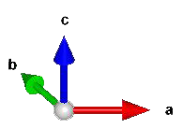
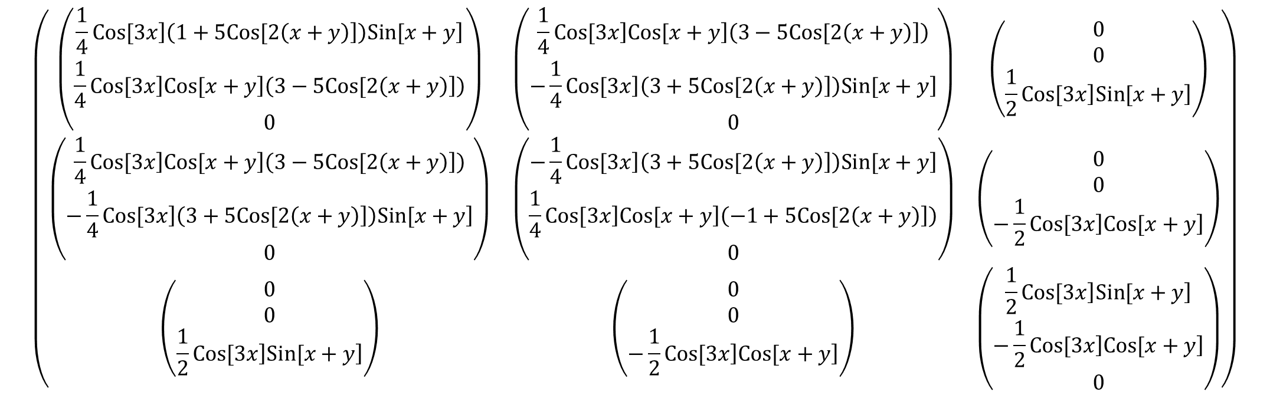
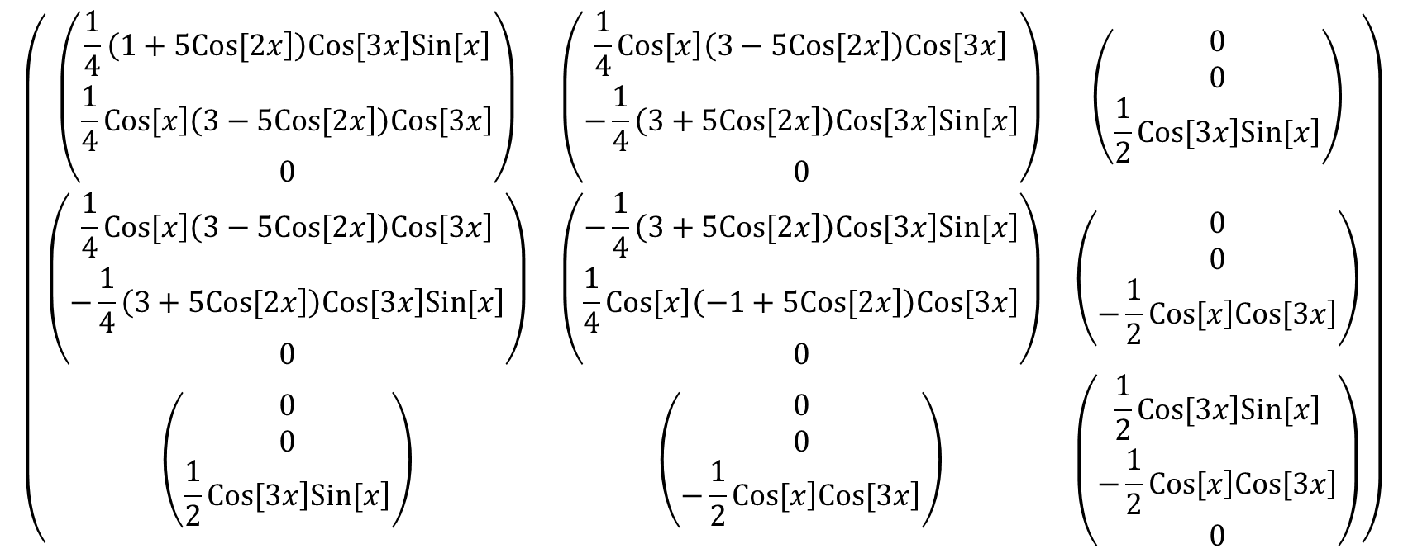
$$\left(\begin{matrix}\left(\begin{matrix}\frac{1}{4}⁢\left.Cos[3⁢x\right]⁢\left(1+5⁢\left.Cos[2⁢\left(x+y\right)\right]\right)⁢\left.Sin[x+y\right] \\ \frac{1}{4}⁢\left.Cos[3⁢x\right]⁢\left.Cos[x+y\right]⁢\left(3−5⁢\left.Cos[2⁢\left(x+y\right)\right]\right) \\ 0\end{matrix}\right) & \left(\begin{matrix}\frac{1}{4}⁢\left.Cos[3⁢x\right]⁢\left.Cos[x+y\right]⁢\left(3−5⁢\left.Cos[2⁢\left(x+y\right)\right]\right) \\ −\frac{1}{4}⁢\left.Cos[3⁢x\right]⁢\left(3+5⁢\left.Cos[2⁢\left(x+y\right)\right]\right)⁢\left.Sin[x+y\right] \\ 0\end{matrix}\right) & \left(\begin{matrix}0 \\ 0 \\ \frac{1}{2}⁢\left.Cos[3⁢x\right]⁢\left.Sin[x+y\right]\end{matrix}\right) \\ \left(\begin{matrix}\frac{1}{4}⁢\left.Cos[3⁢x\right]⁢\left.Cos[x+y\right]⁢\left(3−5⁢\left.Cos[2⁢\left(x+y\right)\right]\right) \\ −\frac{1}{4}⁢\left.Cos[3⁢x\right]⁢\left(3+5⁢\left.Cos[2⁢\left(x+y\right)\right]\right)⁢\left.Sin[x+y\right] \\ 0\end{matrix}\right) & \left(\begin{matrix}−\frac{1}{4}⁢\left.Cos[3⁢x\right]⁢\left(3+5⁢\left.Cos[2⁢\left(x+y\right)\right]\right)⁢\left.Sin[x+y\right] \\ \frac{1}{4}⁢\left.Cos[3⁢x\right]⁢\left.Cos[x+y\right]⁢\left(−1+5⁢\left.Cos[2⁢\left(x+y\right)\right]\right) \\ 0\end{matrix}\right) & \left(\begin{matrix}0 \\ 0 \\ −\frac{1}{2}⁢\left.Cos[3⁢x\right]⁢\left.Cos[x+y\right]\end{matrix}\right) \\ \left(\begin{matrix}0 \\ 0 \\ \frac{1}{2}⁢\left.Cos[3⁢x\right]⁢\left.Sin[x+y\right]\end{matrix}\right) & \left(\begin{matrix}0 \\ 0 \\ −\frac{1}{2}⁢\left.Cos[3⁢x\right]⁢\left.Cos[x+y\right]\end{matrix}\right) & \left(\begin{matrix}\frac{1}{2}⁢\left.Cos[3⁢x\right]⁢\left.Sin[x+y\right] \\ −\frac{1}{2}⁢\left.Cos[3⁢x\right]⁢\left.Cos[x+y\right] \\ 0\end{matrix}\right)\end{matrix}\right)$$
$$\left(\begin{matrix}\left(\begin{matrix}\frac{1}{4}⁢\left(1+5⁢\left.Cos[2⁢x\right]\right)⁢\left.Cos[3⁢x\right]⁢\left.Sin[x\right] \\ \frac{1}{4}⁢\left.Cos[x\right]⁢\left(3−5⁢\left.Cos[2⁢x\right]\right)⁢\left.Cos[3⁢x\right] \\ 0\end{matrix}\right) & \left(\begin{matrix}\frac{1}{4}⁢\left.Cos[x\right]⁢\left(3−5⁢\left.Cos[2⁢x\right]\right)⁢\left.Cos[3⁢x\right] \\ −\frac{1}{4}⁢\left(3+5⁢\left.Cos[2⁢x\right]\right)⁢\left.Cos[3⁢x\right]⁢\left.Sin[x\right] \\ 0\end{matrix}\right) & \left(\begin{matrix}0 \\ 0 \\ \frac{1}{2}⁢\left.Cos[3⁢x\right]⁢\left.Sin[x\right]\end{matrix}\right) \\ \left(\begin{matrix}\frac{1}{4}⁢\left.Cos[x\right]⁢\left(3−5⁢\left.Cos[2⁢x\right]\right)⁢\left.Cos[3⁢x\right] \\ −\frac{1}{4}⁢\left(3+5⁢\left.Cos[2⁢x\right]\right)⁢\left.Cos[3⁢x\right]⁢\left.Sin[x\right] \\ 0\end{matrix}\right) & \left(\begin{matrix}−\frac{1}{4}⁢\left(3+5⁢\left.Cos[2⁢x\right]\right)⁢\left.Cos[3⁢x\right]⁢\left.Sin[x\right] \\ \frac{1}{4}⁢\left.Cos[x\right]⁢\left(−1+5⁢\left.Cos[2⁢x\right]\right)⁢\left.Cos[3⁢x\right] \\ 0\end{matrix}\right) & \left(\begin{matrix}0 \\ 0 \\ −\frac{1}{2}⁢\left.Cos[x\right]⁢\left.Cos[3⁢x\right]\end{matrix}\right) \\ \left(\begin{matrix}0 \\ 0 \\ \frac{1}{2}⁢\left.Cos[3⁢x\right]⁢\left.Sin[x\right]\end{matrix}\right) & \left(\begin{matrix}0 \\ 0 \\ −\frac{1}{2}⁢\left.Cos[x\right]⁢\left.Cos[3⁢x\right]\end{matrix}\right) & \left(\begin{matrix}\frac{1}{2}⁢\left.Cos[3⁢x\right]⁢\left.Sin[x\right] \\ −\frac{1}{2}⁢\left.Cos[x\right]⁢\left.Cos[3⁢x\right] \\ 0\end{matrix}\right)\end{matrix}\right)$$
θ_{roll}

Slide 10
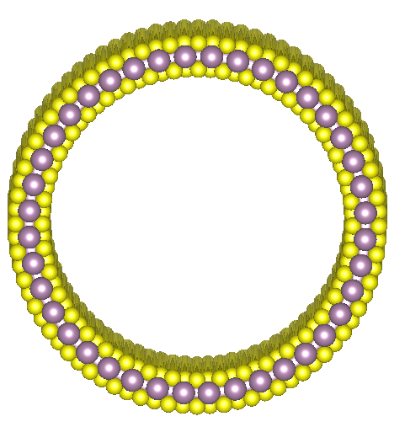
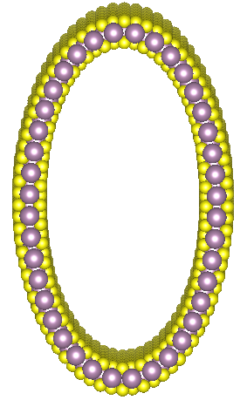
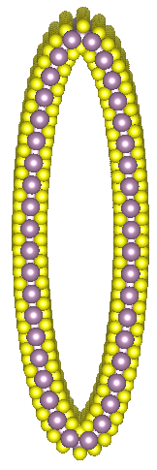
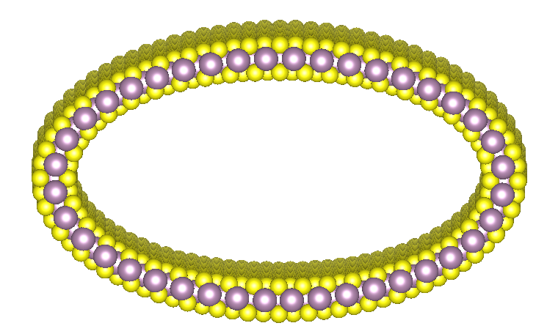
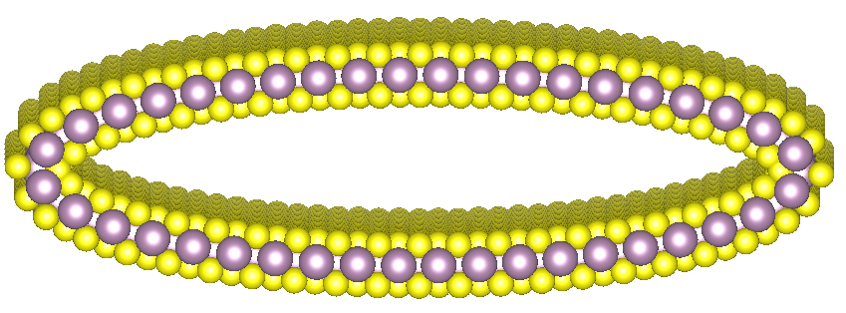
a
b
b
c
a

Slide 11
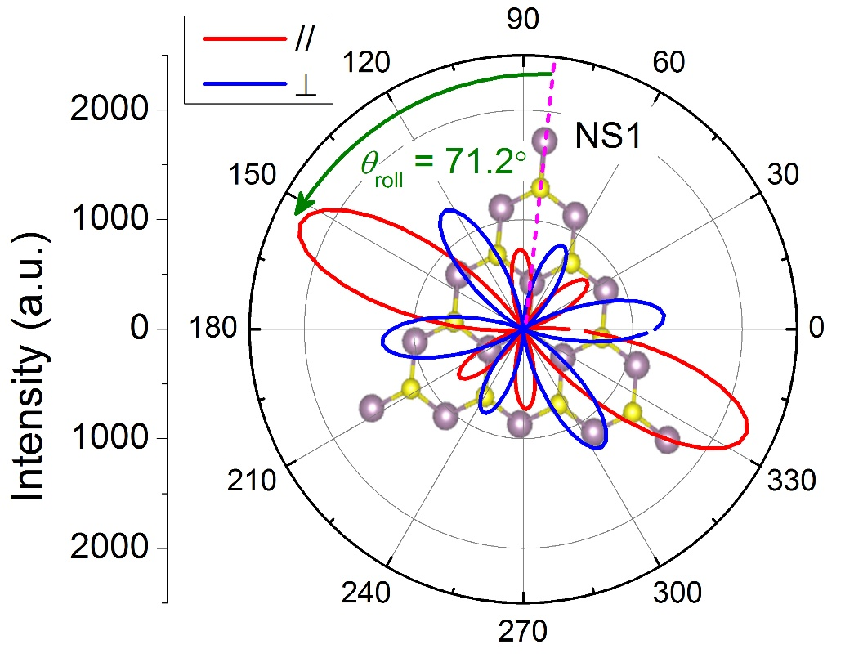
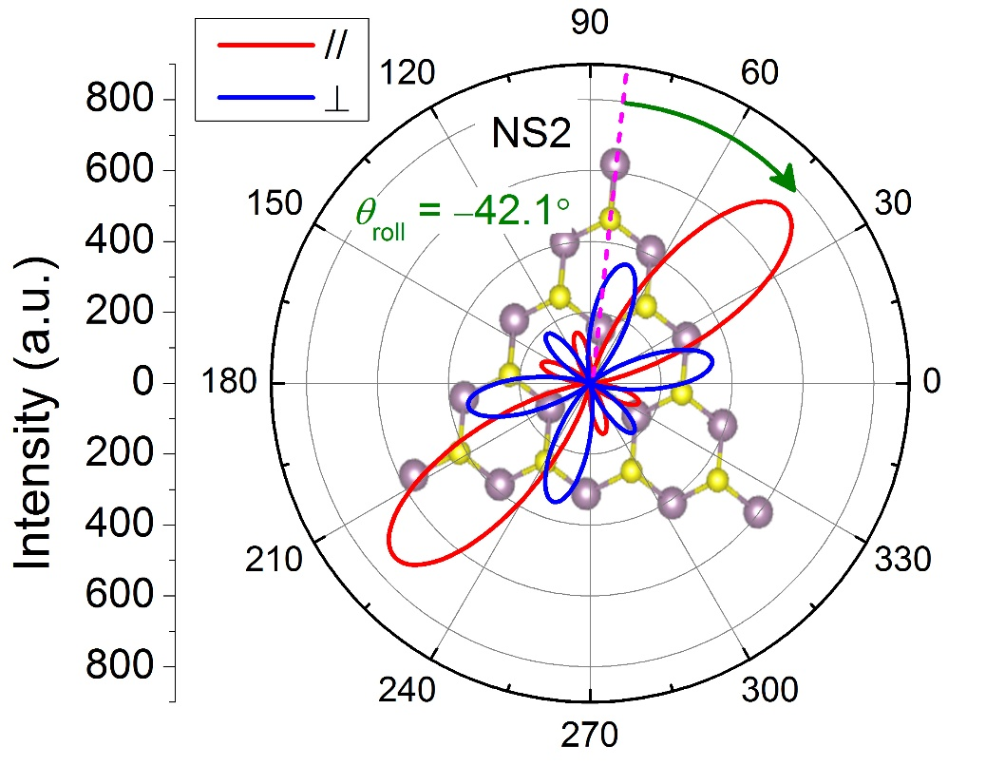
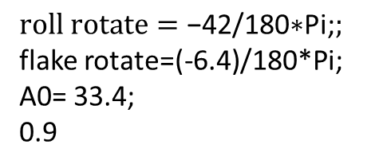
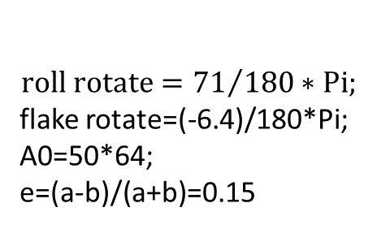
$$roll rotate={71}/{180}∗Pi;$$
flake rotate=(-6.4)/180*Pi;
A0=50*64;
e=(a-b)/(a+b)=0.15
$$roll rotate=\text{−42/180∗}\text{Pi}\text{;};$$
flake rotate=(-6.4)/180*Pi;
A0= 33.4;
0.9
a
b
c
d

Slide 12
$$roll rotate={71}/{180}∗Pi;$$
flake rotate=(-6.4)/180*Pi;
A0=50*64;
e=(a-b)/(a+b)=0.15
$$roll rotate=\text{−42/180∗}\text{Pi}\text{;};$$
flake rotate=(-6.4)/180*Pi;
A0= 33.4;
0.9
a
c
e
b
d
f

Slide 13
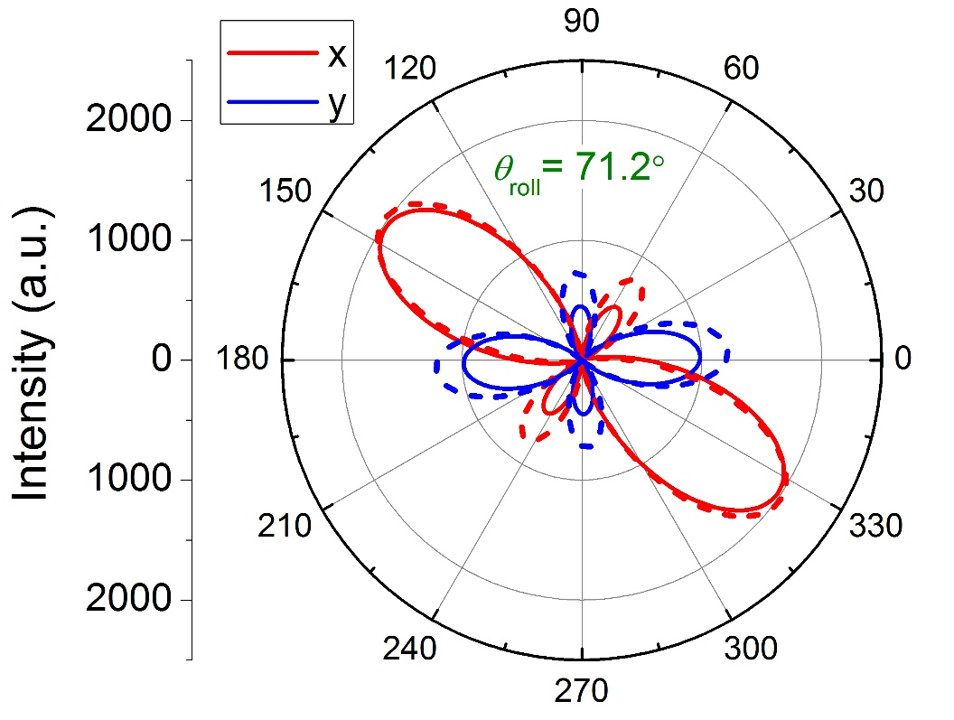
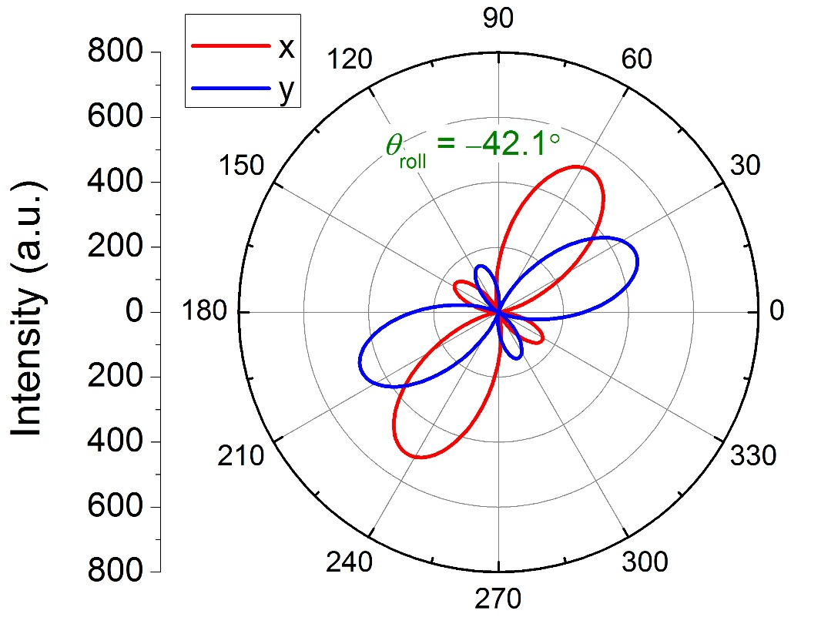
$$roll rotate={71}/{180}∗Pi;$$
flake rotate=(-6.4)/180*Pi;
A0=50*64;
e=(a-b)/(a+b)=0.15
$$roll rotate=\text{−42/180∗}\text{Pi}\text{;};$$
flake rotate=(-6.4)/180*Pi;
A0= 33.4;
0.9
a
c
e
b
d
f

Slide 14
$$roll rotate={71}/{180}∗Pi;$$
flake rotate=(-6.4)/180*Pi;
A0=50*64;
e=(a-b)/(a+b)=0.15
$$roll rotate=\text{−42/180∗}\text{Pi}\text{;};$$
flake rotate=(-6.4)/180*Pi;
A0= 33.4;
0.9
a
c
e
b
d
f

Slide 15
$$roll rotate={71}/{180}∗Pi;$$
flake rotate=(-6.4)/180*Pi;
A0=50*64;
e=(a-b)/(a+b)=0.15
$$roll rotate=\text{−42/180∗}\text{Pi}\text{;};$$
flake rotate=(-6.4)/180*Pi;
A0= 33.4;
0.9
a
c
e
b
d
f

Slide 17
a
b
c

Slide 19
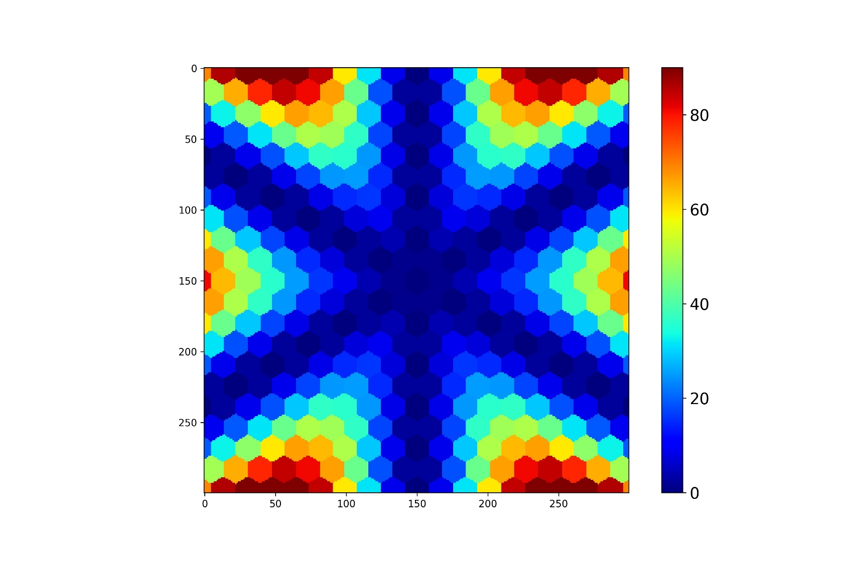
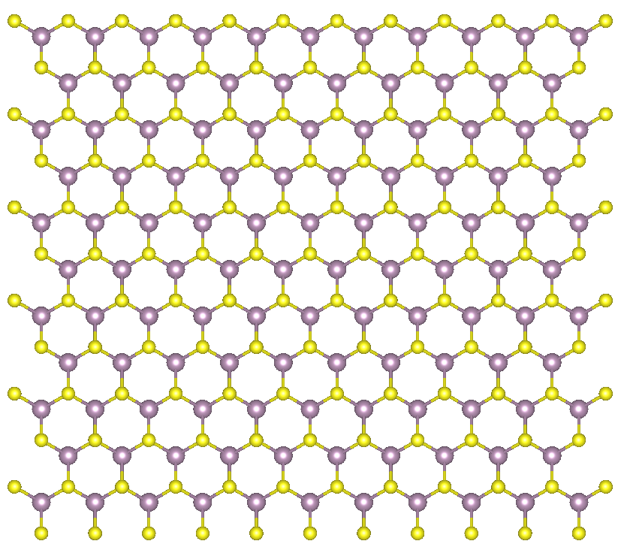
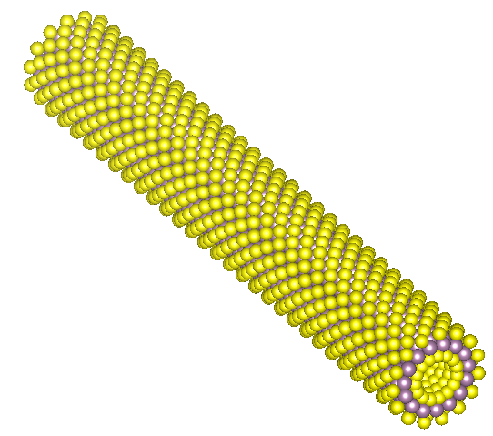
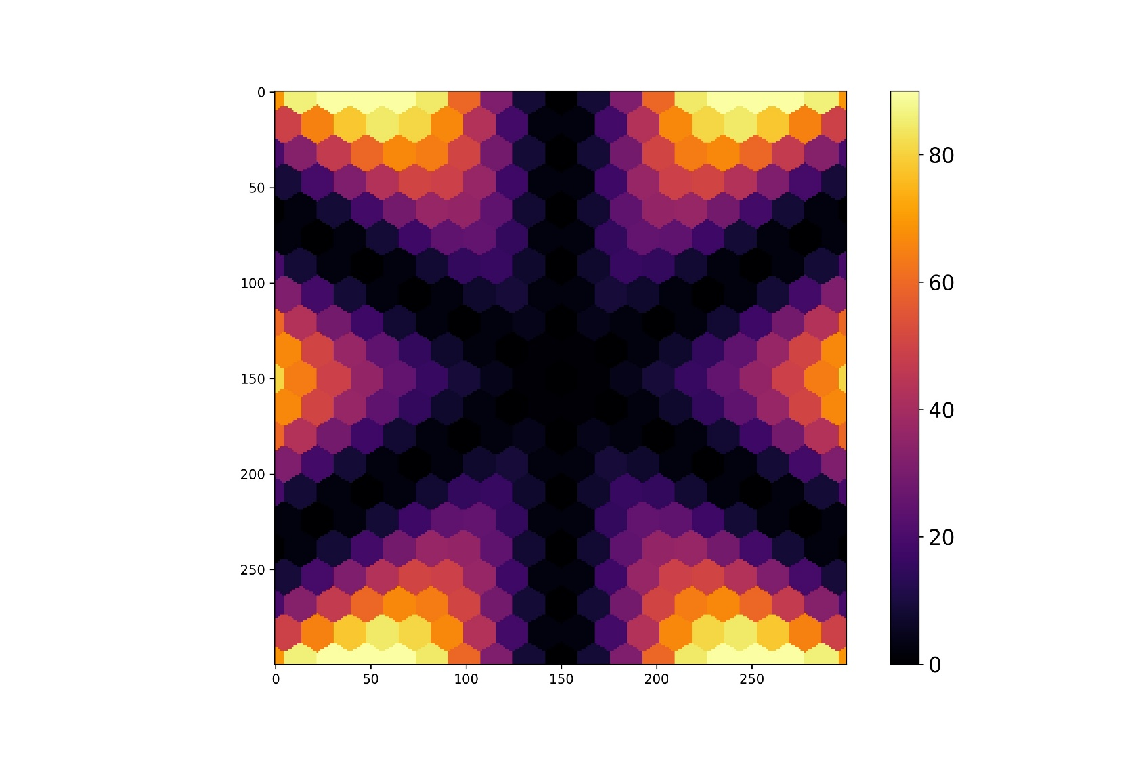
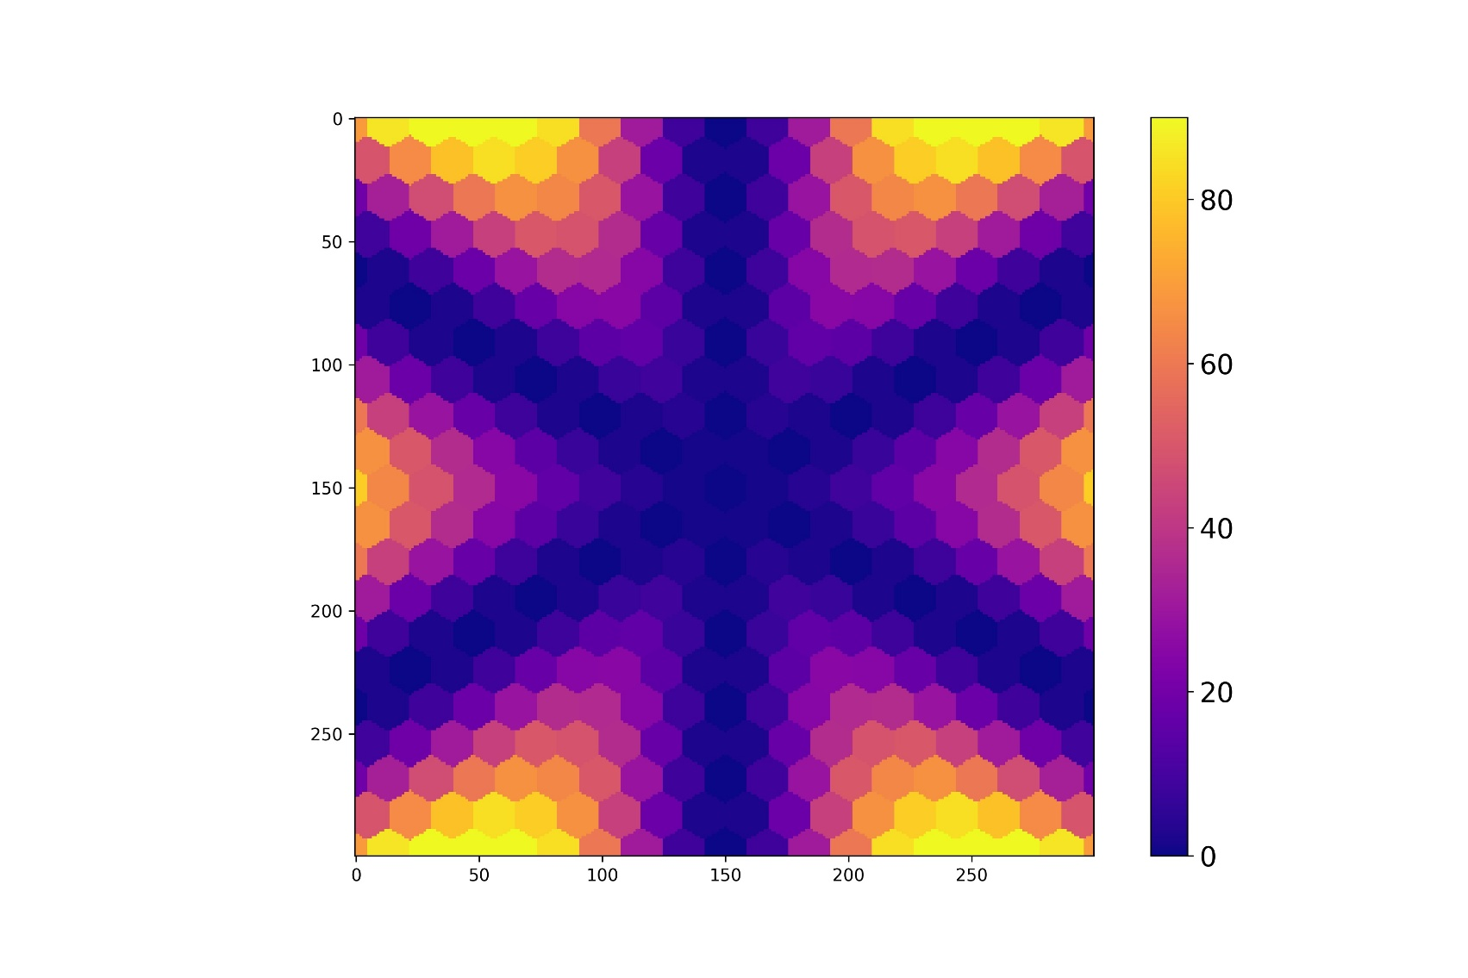
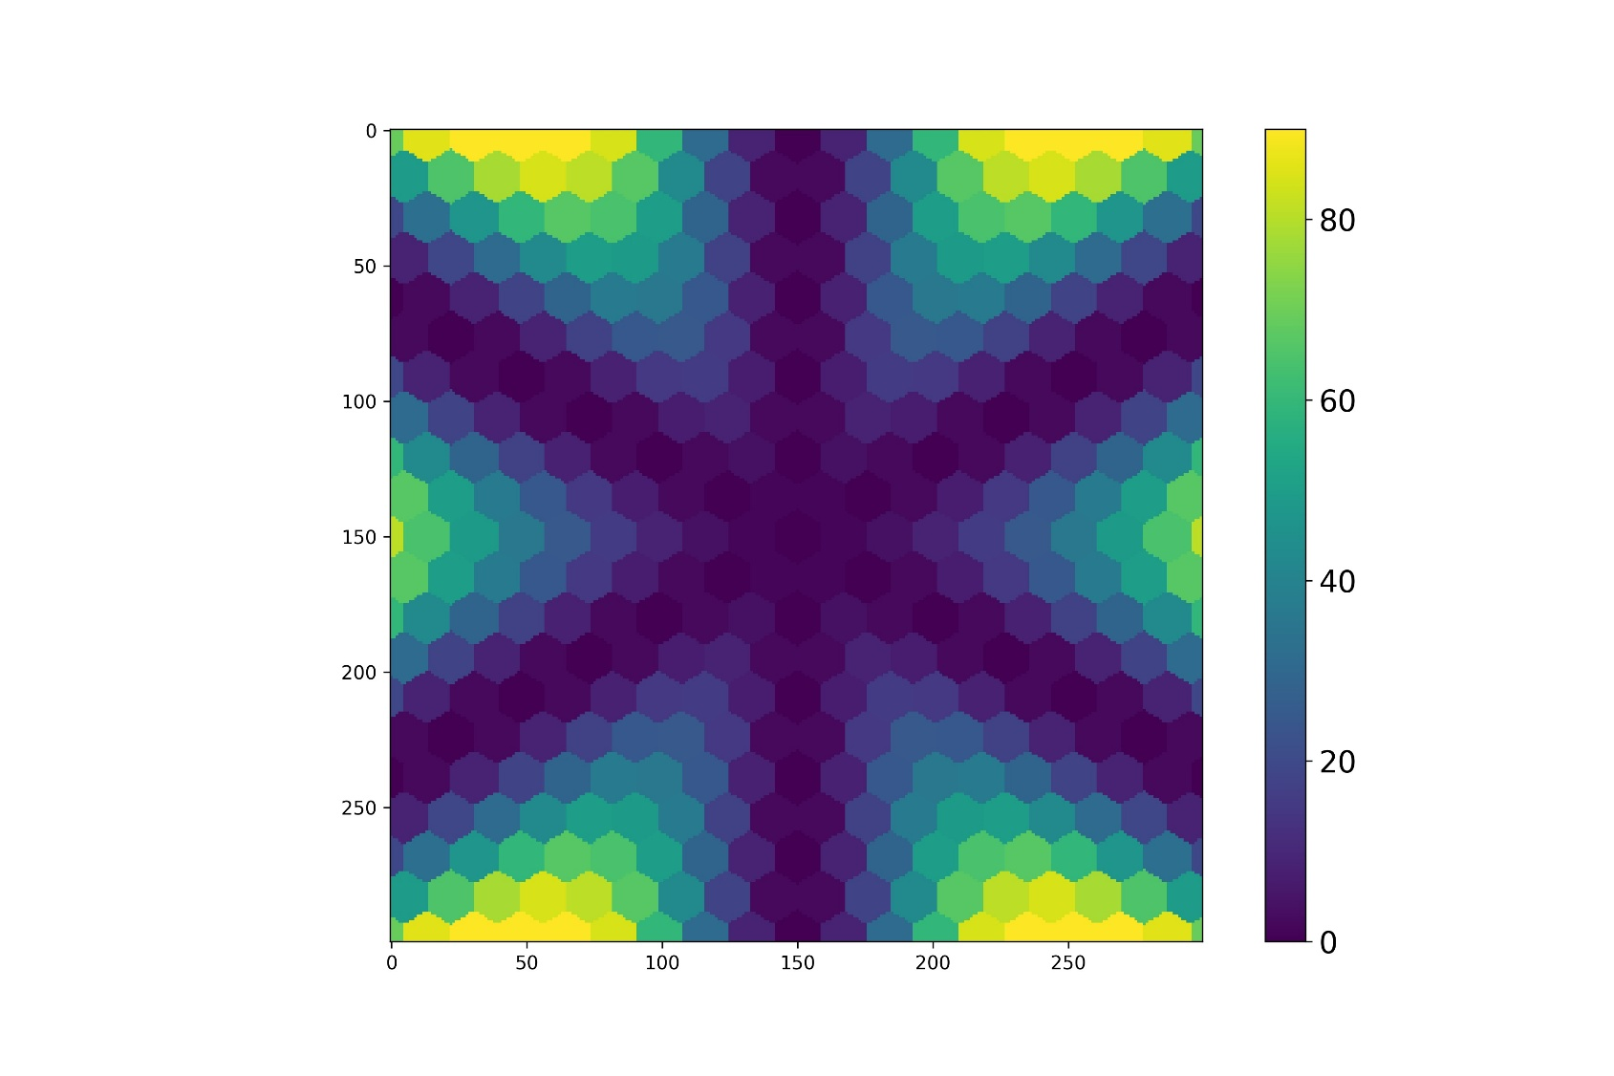
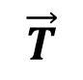


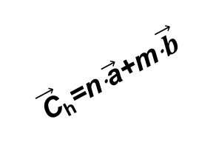
C
b
a
a
$${θ }_{roll}$$
b
c
SHG intensity (a.u)
$$\vec{T}$$
$$\vec{T}$$
C
C_{h}
C_{h}
b
$$\vec{\text{C}}\text{h}\text{=}\text{n}\text{⋅}\vec{\text{a}}\text{+}\text{m}\text{⋅}\vec{b}$$
b
a
b
a
a

Slide 20
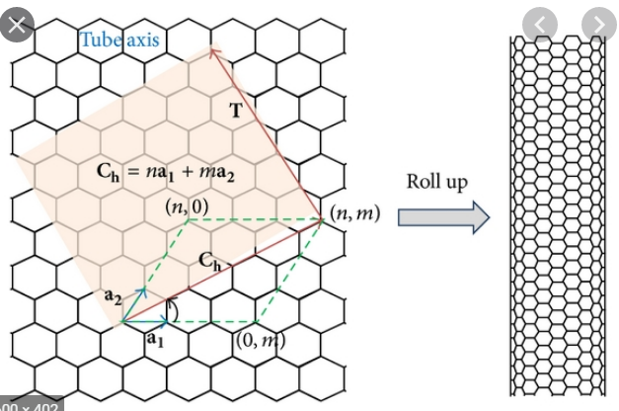
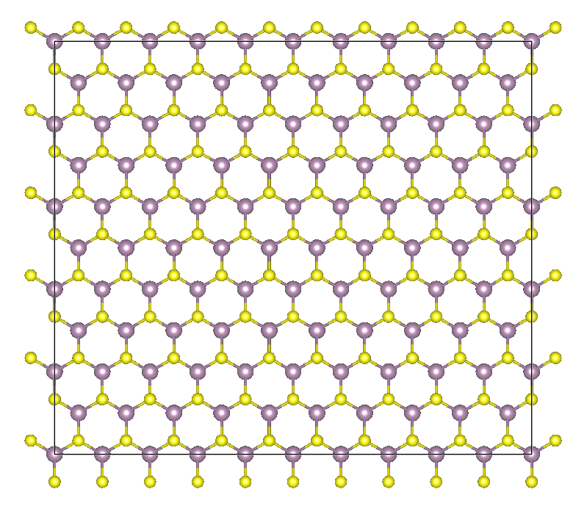
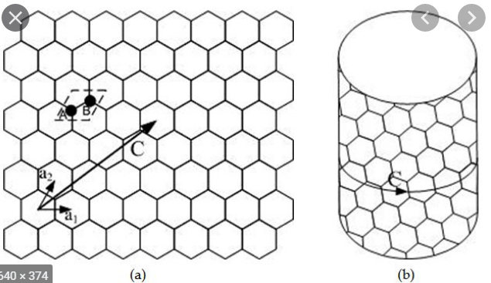

Slide 21
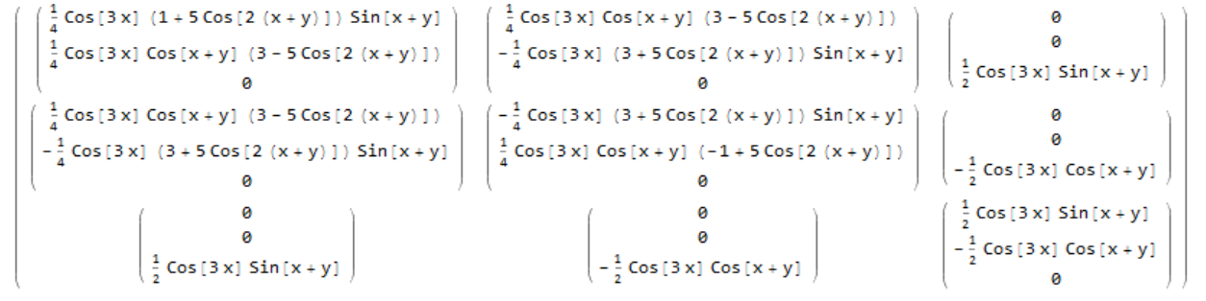
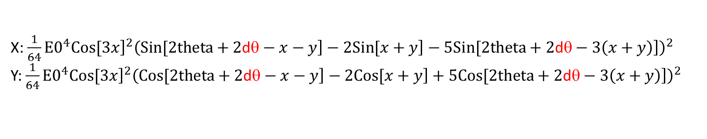
y
x
Roll axis
X: $\frac{1}{64}⁢{E0}^{4}⁢{\left.Cos[3⁢x\right]}^{2}⁢{\left(\left.Sin[2⁢theta+2\text{d}\text{θ}−x−y\right]−2⁢\left.Sin[x+y\right]−5⁢\left.Sin[2⁢theta+2\text{d}\text{θ}−3⁢\left(x+y\right)\right]\right)}^{2}$
Y: $\frac{1}{64}⁢{E0}^{4}⁢{\left.Cos[3⁢x\right]}^{2}⁢{\left(\left.Cos[2⁢theta+2\text{d}\text{θ}−x−y\right]−2⁢\left.Cos[x+y\right]+5⁢\left.Cos[2⁢theta+2\text{d}\text{θ}−3⁢\left(x+y\right)\right]\right)}^{2}$

Slide 22


$$\frac{\left(xxx+xyy\right)}{2}+xxy⁢\left.Sin[2⁢theta\right]+\frac{\left(xxx−xyy\right)}{2}⁢\left.Cos[2⁢theta\right]$$
$${\left.Abs[xxx⁢{\left.Cos[theta\right]}^{2}+xyy⁢{\left.Sin[theta\right]}^{2}+xxy⁢\left.Sin[2⁢theta\right]\right]}^{2}$$

Slide 23




x
Roll axis
Roll axis 0
Roll axis 30
Roll axis 60

Slide 24





$$roll rotate={71}/{180}∗Pi;$$
flake rotate=(-6.4)/180*Pi;
A0=50;
$$roll rotate={71}/{180}∗Pi;$$
flake rotate=(-6.4)/180*Pi;
A0=50*64;
e=(a-b)/(a+b)=0.15
4.1º corrected and xy switch
Theory
Theory
0
-5.4
-42.1
71.4
$$roll rotate=\text{−42/180∗}\text{Pi}\text{;};$$
flake rotate=(-6.4)/180*Pi;
A0= 33.4;
$$roll rotate=\text{−42/180∗}\text{Pi}\text{;};$$
flake rotate=(-6.4)/180*Pi;
A0= 33.4;
0.9
Theory
4.1º corrected

Slide 25


$$Fixed detection at x: χE^{2}\cos\left(2θ−3φ\right)$$
$$Both rotated detection: χE^{2}\cos\left(3θ−3φ\right)$$
11º misalignment
$$φ=\frac{2}{3}×θ=32o$$
Rotation 74-30=44º
Polarization 22.5

Slide 26

E_{in}(ω)
E_{in}(ω)
E_{in}(ω)
E_{in}(ω)
E_{out}(2ω)
E_{out}(2ω)
E_{out}(2ω)
E_{out}(2ω)
θ_{roll}
θ_{roll} = 0°
θ_{roll} = 0°
θ_{roll} = -30°
θ_{roll} = -30°

Slide 27
E_{in}(ω)
E_{in}(ω)
E_{out}(2ω)
E_{out}(2ω)

Slide 28

2020-Disassembling 2D van der Waals crystals into macroscopic monolayers and reassembling into artificial lattices

Slide 29

2013-Grains and grain boundaries in highly crystalline monolayer molybdenum disulphide

Slide 30
$${E_{l}^{2ω}}^{′}=R_{li}E_{i}^{2ω}=R_{li}χ_{ijk}^{\left(2\right)}E_{j}^{ω}E_{k}^{ω}=R_{li}χ_{ijk}^{\left(2\right)}δ_{jm}δ_{kn}E_{m}^{ω}E_{n}^{ω}=R_{li}χ_{ijk}^{\left(2\right)}{R^{−1}}_{jo}{R^{−1}}_{kp}R_{om}R_{pn}E_{m}^{ω}E_{n}^{ω}$$

Slide 31



a
b

Slide 32


a
b

Slide 33


80 nm
150 nm
5 μm
1 μm
-100 nm
-200 nm

Slide 34

80 nm
1 μm
-100 nm

Slide 35


a
b
39
206
43
205
35
160
c
d

Slide 40

$$\left(\begin{matrix}\left(\begin{matrix}\left.Sin[3⁢theta\right] \\ −\left.Cos[3⁢theta\right] \\ 0\end{matrix}\right) & \left(\begin{matrix}−\left.Cos[3⁢theta\right] \\ −\left.Sin[3⁢theta\right] \\ 0\end{matrix}\right) & \left(\begin{matrix}0 \\ 0 \\ 0\end{matrix}\right) \\ \left(\begin{matrix}−\left.Cos[3⁢theta\right] \\ −\left.Sin[3⁢theta\right] \\ 0\end{matrix}\right) & \left(\begin{matrix}−\left.Sin[3⁢theta\right] \\ \left.Cos[3⁢theta\right] \\ 0\end{matrix}\right) & \left(\begin{matrix}0 \\ 0 \\ 0\end{matrix}\right) \\ \left(\begin{matrix}0 \\ 0 \\ 0\end{matrix}\right) & \left(\begin{matrix}0 \\ 0 \\ 0\end{matrix}\right) & \left(\begin{matrix}0 \\ 0 \\ 0\end{matrix}\right)\end{matrix}\right)$$

Slide 41

$$\left(\begin{matrix}\left(\begin{matrix}\frac{1}{4}⁢\cos{3θ_{roll}}\sin{ϕ}\left(1+5⁢\cos{2ϕ}\right)⁢ \\ \frac{1}{4}\cos{3θ_{roll}}\cos{ϕ}\left(3−5⁢\cos{2ϕ}\right) \\ 0\end{matrix}\right) & \left(\begin{matrix}\frac{1}{4}⁢\cos{3θ_{roll}}\cos{ϕ}\left(3−5⁢\cos{2ϕ}\right) \\ −\frac{1}{4}⁢\cos{3θ_{roll}}\sin{ϕ}\left(3+5⁢\cos{2ϕ}\right)⁢ \\ 0\end{matrix}\right) & \left(\begin{matrix}0 \\ 0 \\ \frac{1}{2}⁢\cos{3θ_{roll}}\sin{ϕ}\end{matrix}\right) \\ \left(\begin{matrix}\frac{1}{4}⁢\cos{3θ_{roll}}\cos{ϕ}\left(3−5\cos{2ϕ}\right) \\ −\frac{1}{4}⁢\cos{3θ_{roll}}\sin{ϕ}\left(3+5⁢\cos{2ϕ}\right)⁢ \\ 0\end{matrix}\right) & \left(\begin{matrix}−\frac{1}{4}⁢\cos{3θ_{roll}}\sin{ϕ}\left(3+5⁢\cos{2ϕ}\right)⁢ \\ \frac{1}{4}⁢\cos{3θ_{roll}}\cos{ϕ}\left(−1+5⁢\cos{2ϕ}\right) \\ 0\end{matrix}\right) & \left(\begin{matrix}0 \\ 0 \\ −\frac{1}{2}⁢\cos{3θ_{roll}}⁢\cos{ϕ}\end{matrix}\right) \\ \left(\begin{matrix}0 \\ 0 \\ \frac{1}{2}⁢\cos{3θ_{roll}}\sin{ϕ}\end{matrix}\right) & \left(\begin{matrix}0 \\ 0 \\ −\frac{1}{2}⁢\cos{3θ_{roll}}\cos{ϕ}\end{matrix}\right) & \left(\begin{matrix}\frac{1}{2}⁢\cos{3θ_{roll}}\sin{ϕ} \\ −\frac{1}{2}\cos{3θ_{roll}}⁢\cos{ϕ} \\ 0\end{matrix}\right)\end{matrix}\right)$$

Slide 42


$$\cos{3θ_{roll}}\sin{ϕ}\left(3+5⁢\cos{2ϕ}\right)$$
$$\frac{1}{64}⁢{E_{0}}^{4}⁢\cos^{2} 3θ_{roll}⁢{\left\{−5⁢sin(2⁢θ−3⁢ϕ)+sin(2⁢θ−ϕ)−2⁢sinϕ\right\}}^{2}$$
$$\frac{1}{64}⁢{E_{0}}^{4}⁢\cos^{2} 3θ_{roll}⁢{\left\{3⁢sin\left(⁢θ−ϕ\right)−5sin(3⁢θ−3ϕ) \right\}}^{2}$$
$$\frac{1}{8}⁢{E0}^{2}⁢\left.Cos[3⁢x\right]⁢\left(3⁢\left.Sin[theta−y\right]−5⁢\left.Sin[3⁢\left(theta−y\right)\right]\right)$$

Slide 43




1
P3

Slide 44

$$Fixed detection at x: χE^{2}\cos\left(2θ−3φ\right)$$
11º misalignment
$$φ=\frac{2}{3}×θ=21o$$
58º
X polarization
Rotate -(58-30)=-28º or 32º
P2
P1
Polarization 33º, real angle 37.1º
Wrong switch between x and y

Slide 45



Raman tensor and rotation
Raman tensor R_{ijk}
ER_{i}= R_{ijk} E_{j} E_{k}
Rotation of axis
E_{j}’=Rot_{ij}E_{j}
E_{i}=Rot_{ij}⁻¹E_{j}’
Roted Raman tensor R_{ijk}’
E_{m}’=Rot_{mi} ER_{i}= Rot_{mi} R_{ijk} Rot_{jn}⁻¹ Rot_{kp}⁻¹ E_{n}’ E_{p}’
R_{mnp}’= Rot_{mi} R_{ijk} Rot_{jn}⁻¹ Rot_{kp}⁻¹
Rotate x degree

Slide 46






Angle correction from mapping
y
x=ɸ
Fitting method
dθ
4.1º corrected
x
ɸ=-6.4º
X detection:
(-E₀² Sin[2 θ-3 ɸ+2 dθ])²
Y detection:
(-E₀² Cos[2 θ-3 ɸ+2 dθ])²
dθ
-3 ɸ+2 dθ= 27.4364º
ɸ=-5.25º~-6.4º
dθ=5.84º~4.1º
X polarization
//: ${E0}^{4}⁢{\left.Sin[3⁢\left(−phi+theta\right)\right]}^{2}$
$$rot0={\left(−6.4\right)}/{180}∗Pi;$$
$$A0=23.32;$$
$$X: {E0}^{4}⁢{\left.Sin[−3⁢phi+2⁢theta\right]}^{2}$$
Y: ${E0}^{4}⁢{\left.Cos[−3⁢phi+2⁢theta\right]}^{2}$
|_: ${E0}^{4}⁢{\left.Cos[3⁢\left(−phi+theta\right)\right]}^{2}$

Slide 47
Theory to get // and /_
4.1º corrected
X detection:
(-E₀² Sin[2 θ-3 ɸ])²
Y detection:
(-E₀² Cos[2 θ-3 ɸ])²
Theory

Slide 48
Roll angle
Polarization 33º, real angle 37.1º
0
119.2
83.8
-5.4
47.1
-42.1
-12.4
78.4

Slide 49
y
x
Roll axis
X: $\frac{1}{64}⁢{E0}^{4}⁢{\left.Cos[3⁢x\right]}^{2}⁢{\left(\left.Sin[2⁢theta+2\text{d}\text{θ}−x−y\right]−2⁢\left.Sin[x+y\right]−5⁢\left.Sin[2⁢theta+2\text{d}\text{θ}−3⁢\left(x+y\right)\right]\right)}^{2}$
Y: $\frac{1}{64}⁢{E0}^{4}⁢{\left.Cos[3⁢x\right]}^{2}⁢{\left(\left.Cos[2⁢theta+2\text{d}\text{θ}−x−y\right]−2⁢\left.Cos[x+y\right]+5⁢\left.Cos[2⁢theta+2\text{d}\text{θ}−3⁢\left(x+y\right)\right]\right)}^{2}$

Slide 50



4.1º corrected and xy switch
0
$y$=ɸ=-5.25º~-6.4º
dθ=5.84º~4.1º
78.4
$$roll rotate={71}/{180}∗Pi;$$
flake rotate=(-6.4)/180*Pi;
A0=50;
$$roll rotate={71}/{180}∗Pi;$$
flake rotate=(-6.4)/180*Pi;
A0=50*64;
e=(a-b)/(a+b)=0.15
Theory

Slide 51
Theory
Intensity correction
Theory
Intensity correction

Slide 52




4.1º corrected
0
-42.1
$y$=ɸ=-5.25º~-6.4º
dθ=5.84º~4.1º
$$roll rotate=\text{−42/180∗}\text{Pi}\text{;};$$
flake rotate=(-6.4)/180*Pi;
A0= 33.4;
$$roll rotate=\text{−42/180∗}\text{Pi}\text{;};$$
flake rotate=(-6.4)/180*Pi;
A0= 33.4;
0.9
$$roll rotate=\text{71}\text{/180∗}\text{Pi}\text{;};$$
flake rotate=(-6.4+20)/180*Pi;
A0= 50;
0.1

Slide 53
Theory
Intensity correction

Slide 54
x
Roll axis
Roll axis 0
Roll axis 30
Roll axis 60

Slide 55
http://www.physics.ucc.ie/fpetersweb/FrankWeb/courses/PY4118/Notes/Symmetry%20of%20Tensor%202.pdf

Slide 56






SHG for TMDs
$$χ_{\text{yyy}}=χ$$
$$χ_{\text{xx}\text{y} }=−χ$$
$$χ_{\text{x}\text{y}\text{x} }=−χ$$
$$χ_{\text{y}\text{x}\text{x} }=−χ$$

Slide 57



Single-point measurement:
x, y, xy polarization to calculate // and |_
Mapping
Incident between edge, setting $polarization=\frac{2}{3}×θmax$
Map with x, y, xy
$$φ=\frac{2}{3}×θ=21o$$
$$Fixed detection at x: χE^{2}\cos\left(2θ−3φ\right)$$
$$Both rotated detection: χE^{2}\cos\left(3θ−3φ\right)$$

Slide 58


Experiment
Theory

Slide 59




0º
10º
20º
30º

Slide 60



30º
40º
50º
60º

Slide 61




0º
10º
20º
30º

Slide 62



30º
40º
50º
60º

Slide 63





0º
20º
40º
60º
80º
90º

Slide 64






0º
20º
40º
60º
80º
90º

Slide 65
SHG for TMDs
$$χ_{\text{yyy}}=χ$$
$$χ_{\text{xx}\text{y} }=−χ$$
$$χ_{\text{x}\text{y}\text{x} }=−χ$$
$$χ_{\text{y}\text{x}\text{x} }=−χ$$

Slide 66




dyyy
dxyy

Slide 67
$$Fixed detection at x: χE^{2}\cos\left(2θ−3φ\right)$$
$$Both rotated detection: χE^{2}\cos\left(3θ−3φ\right)$$
11º misalignment
$$φ=\frac{2}{3}×θ=32o$$
Rotation 74-30=44º
Polarization 22.5

Slide 68

11º misalignment
$$φ=\frac{2}{3}×θ=18.7o$$
55º
Rotate 58+30=88º or 28º
Polarization 24

Slide 69


SHG for TMDs
$$χ_{\text{yyy}}=χ$$
$$χ_{\text{xx}\text{y} }=−χ$$
$$χ_{\text{x}\text{y}\text{x} }=−χ$$
$$χ_{\text{y}\text{x}\text{x} }=−χ$$
800nm excitation
Y or p
Detection along x or y
Period: 90º
$$−χE^{2}cos2θ$$
X or s
$$E$$
$$θ$$
$$−χE^{2}sin2θ$$
Excitation laser along θ
//: ${(−χE^{2}sin3θ)}^{2}, detection parallel to E$
|_:${ (−χE^{2}cos3θ)}^{2}, detection perpendicular to E$
Period: 60º

Slide 70











$$−2χE^{2}\cos\left(2θ−\frac{3φ_{1}+3φ_{2}}{2}\right)cos⁡(\frac{3φ_{1}−3φ_{2}}{2})$$
$$\text{Rotate} φ:−χE^{2}cos⁡(2θ−3φ)$$
$$φ2$$
$$φ$$
$$E$$
$$E$$
$$φ1$$
$$θ$$
$$θ$$
$$\text{Rotate} φ:−χE^{2}sin⁡(2θ−3φ)$$
$$−2χE^{2}\sin\left(2θ−\frac{3φ_{1}+3φ_{2}}{2}\right)cos⁡(\frac{3φ_{1}−3φ_{2}}{2})$$

Slide 71




2

Slide 72




3

Slide 73

？

Slide 74
X in x out
X in y out

Slide 75
http://www.physics.ucc.ie/fpetersweb/FrankWeb/courses/PY4118/Notes/Symmetry%20of%20Tensor%202.pdf

Slide 76



Slide 77






YY
Line mapping
33.9 cm-1
37 cm-1

Slide 78











38.8
21.7 cm-1
37.4

Slide 79











21.2 cm-1
15.0 cm-1
24.2 cm-1
21.4 cm-1

Slide 80







WX
21.2 cm-1

Slide 81




21.2 cm-1

Slide 82

2013-Interlayer Breathing and Shear Modes in Few-Trilayer MoS2 and WSe2

Slide 83




30o, good for SHG

